Slide 1


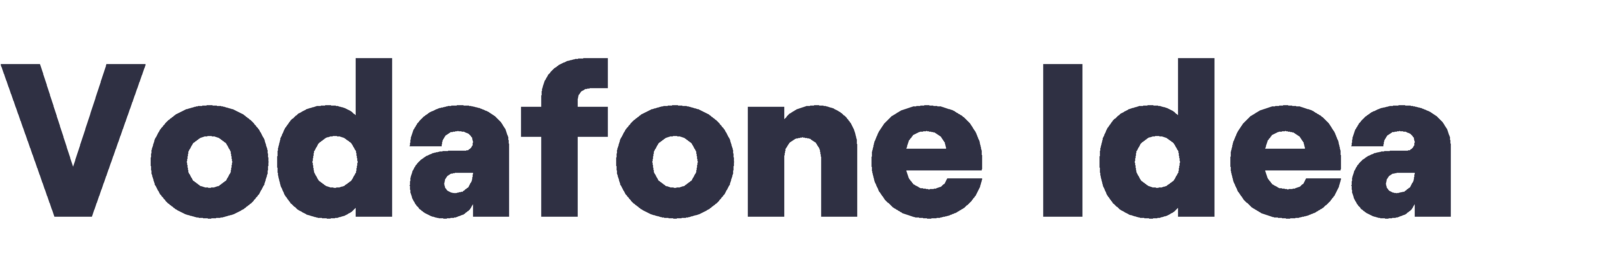



Slide 2



































































❖
❖

Slide 3














































Others 5.8%
43.3%
Vodafone Idea 23.7%
45.6%
44.2%
31.9%
Jio 35.7%
15.9%
Bharti Airtel 34.8%
9.0%
10.2%
Bharti | Vodafone | Jio | BSNL | Bharti | Vodafone | BSNL
Airtel | Idea |  |  | Airtel | Idea

Slide 4













































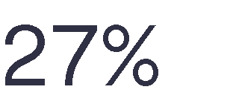
























1,086
•
282
400
•
Sub-GHz (800/900)
Supra-GHz (1,800/2,100)
TDD (2,300/2,500)
•
977
790
326
Sub-GHz
(800/900)
Supra-GHz
(1,800/2,100)
TDD
(2,300/2,500)
•
880
•
410
442
Sub-GHz (800/900)
Supra-GHz TDD (1,800/2,100) (2,300/2,500)

Slide 5
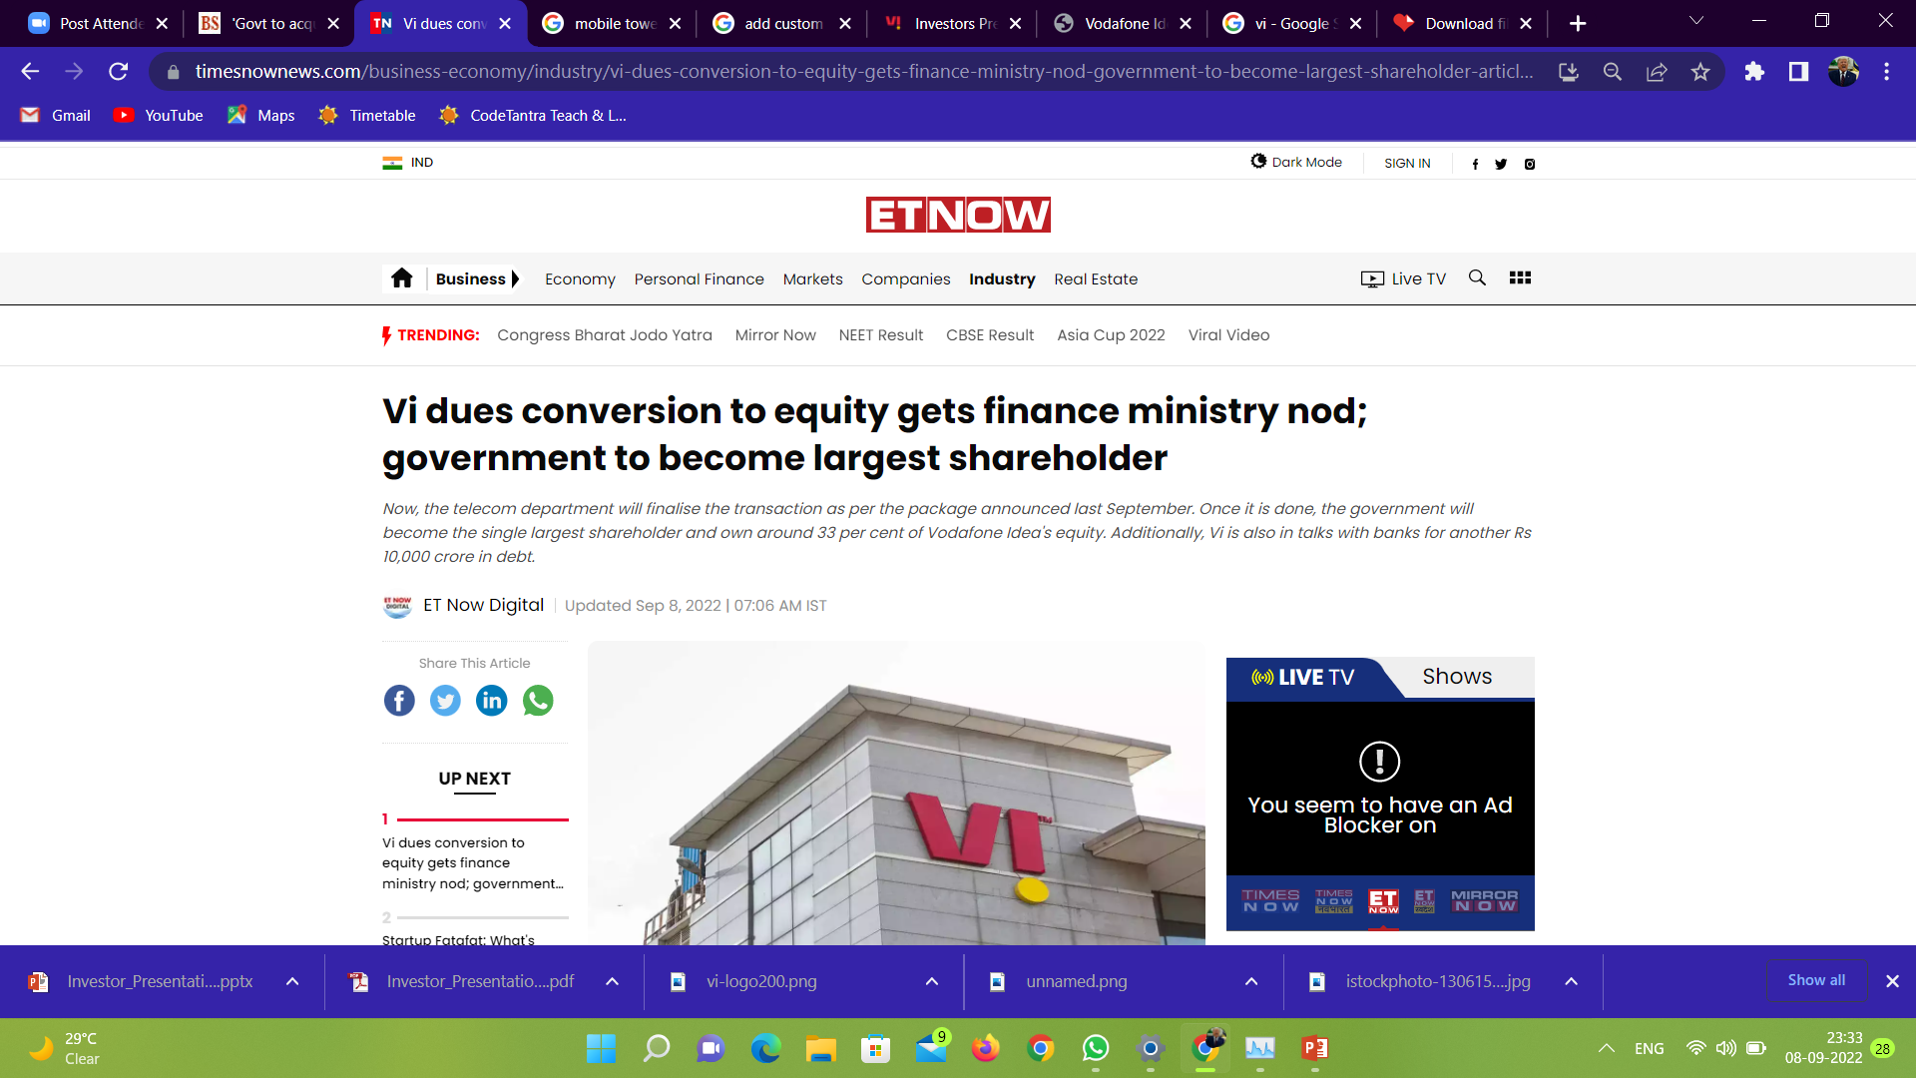
Vi dues conversion to equity gets finance ministry nod
Pending since January this year, cash-strapped Vodafone Idea's Rs 16,130-crore worth of accrued interest on deferred adjusted gross revenue (AGR)-related dues will be converted into equity. A proposal concerning the same has received a nod from the finance ministry.
"It (the equity conversion) has received the finance ministry's nod in line with the approved (telecom relief) package," an official aware of the developments told Economic Times.
-According to timesanownews.com

Slide 6
Vi equity conversion
Equity conversion is important for Vodafone Idea, which bought airwaves worth Rs 18,799 crore in the 5G spectrum auctions, to get its long-due Rs 10,000 crore external fundraise via equity done as potential investors seek clarity on this issue.
Additionally, to put in more money into its 4G network and launch 5G services, Vi is also in talks with banks for another Rs 10,000 crore in debt. Vi will be facing rivals Reliance Jio – the biggest bidder in the auction - and Bharti Airtel in the 5G race.
-According to timesanownews.com

Slide 7
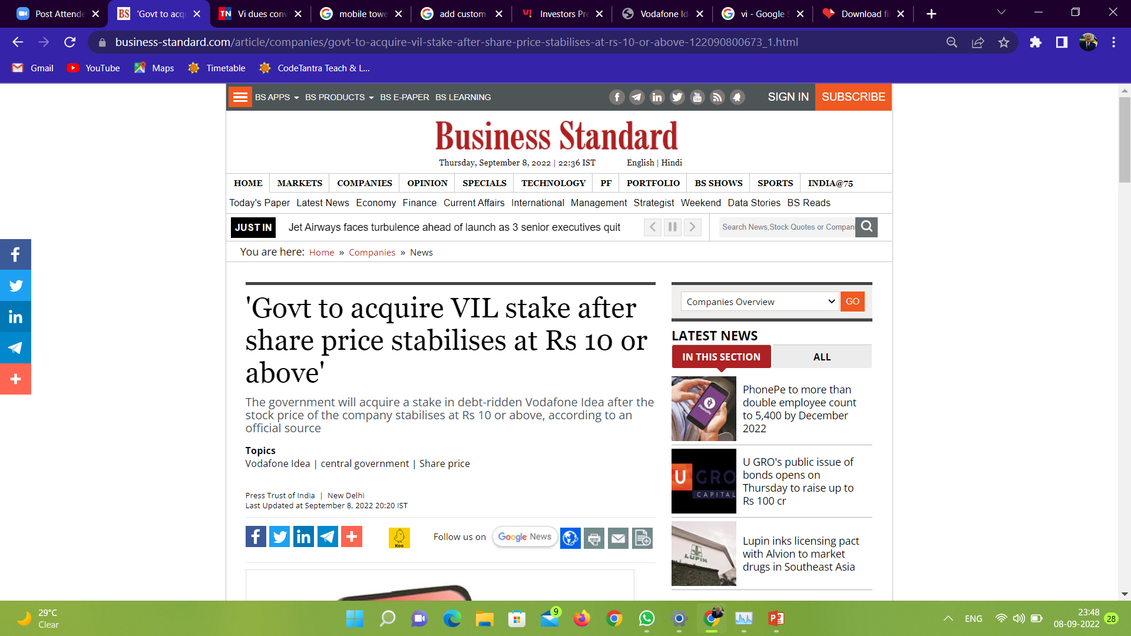
The government will acquire a stake in debt-ridden Vodafone Idea after the stock price of the company stabilises at Rs 10 or above, according to an official source.
Vodafone Idea (VIL) board has offered a stake to the government at a par value of Rs 10 per share.
"There is a SEBI norm that the acquisition should take place at par value. DoT will clear the acquisition after VIL shares stabilise at Rs 10 or above," an official source told PTI.
VIL shares are trading below Rs 10 since April 19. The stock declined by 1.02 per cent to trade at Rs 9.68 on BSE on Thursday.
-According to business-standard.com

Slide 8
-According to business-standard.com
Debt-ridden Vodafone Idea (VIL) has decided to opt for converting about Rs 16,000 crore of interest liability payable to the government into equity which will amount to around 33 per cent stake in the company while promoters' holding will come down from 74.99 per cent to 50 per cent.

Slide 9
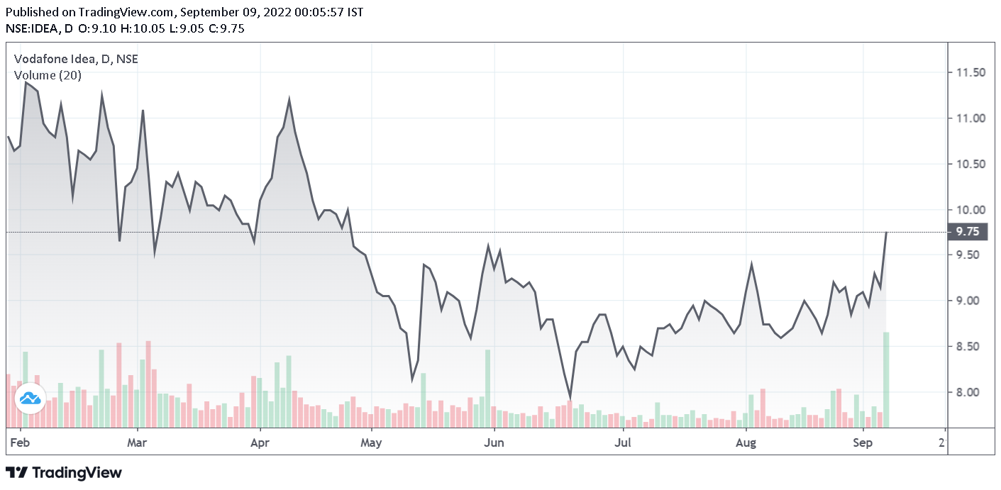
Impact of this news on stocks of VI :
Closing on 6th September: ₹ 9.14
Closing on 7th September: ₹ 9.75

Slide 10




